Slide 1
Why a higher degree of recycling really matters

Slide 2
A higher recycling rate
We need to recycle as much as possible, and to a high degree as possible
We all benefit from this, as better recycling is the basis for creating sustainability in general and in your business in specific.
Better recycling saves time, material, energy and money.
Notes:
There are several gains and benefits coming from recycling to a higher degree – all showing the importance to businesses in specific and for society as a whole in general.

Slide 3
A higher recycling rate
reasons for a higher recycling rate
Material quality
Preventing material loss
Sustainability values
Improved processes
Less climate impact

Slide 4
A higher recycling rate
Better material quality
Better recycling provides better material, which in its turn brings more value.
Improved processes and methods will improve the quality of the recycled materials. It attracts a growing market for recycled materials.
With improved material quality it is likely that the prices will grow.

Slide 5
A higher recycling rate
Preventing material loss
When you improve your recycling rate it will automatically lift the material up the waste hierarchy. (bild på avfallstrappan)
Focus on early material sorting. Separating waste makes sure that the different metals can be used more efficiently.
When steel is sorted correctly, there can be a more than the doubled price for the material compared to poorly sorted steel. This also prevents the downgrading of the material.

Slide 6
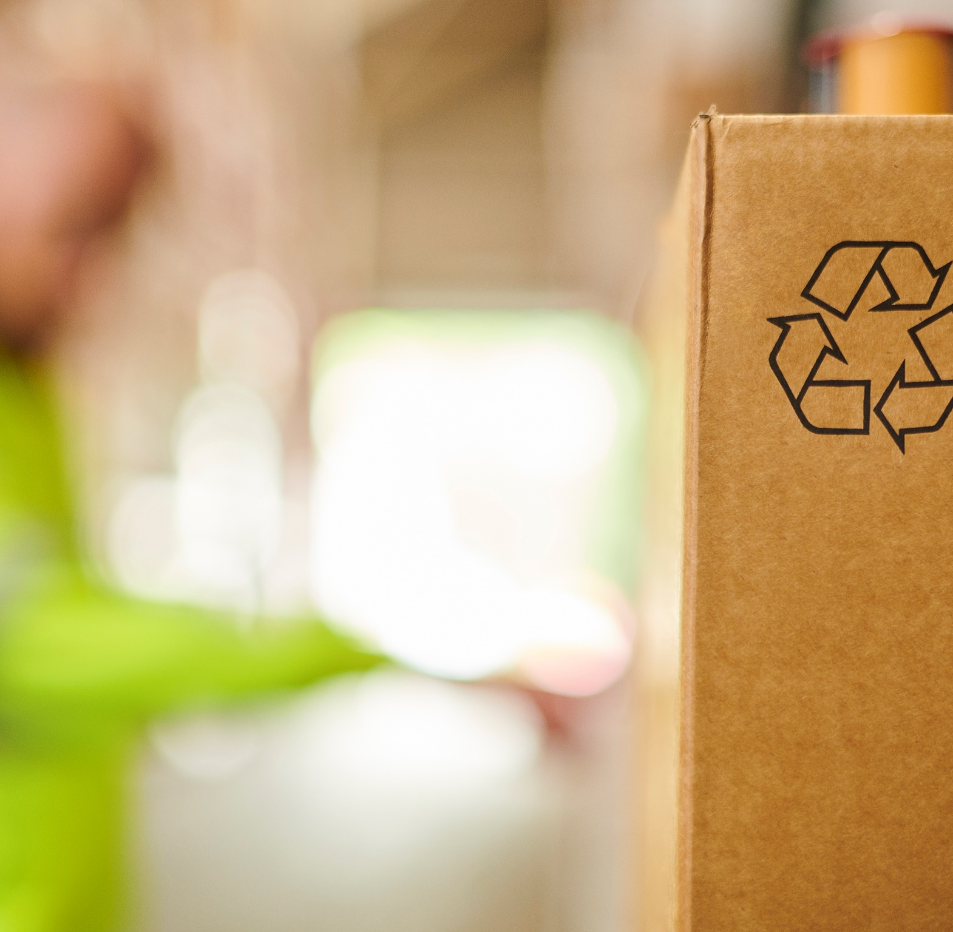
A higher recycling rate
sustainability values
A higher degree of recycling decrease the need for virgin material, like metal ore.
This can be achieved by improving all parts of the production chain, from design to waste handling.
One important part is design for recycling. No product should be designed to be thrown away at its end-of-life.
Maximizing the material handling, keeps production spill to a minimum.
Support and train your staff, they are important to achieve efficient waste sorting.

Slide 7
A higher recycling rate
Improved/new processes
Stena Recycling can help you tailor the reuse and recycling processes to your needs.
Through our different industrial partnerships, we secure that your material can be used in new products, regardless of the material’s original use.

Slide 8
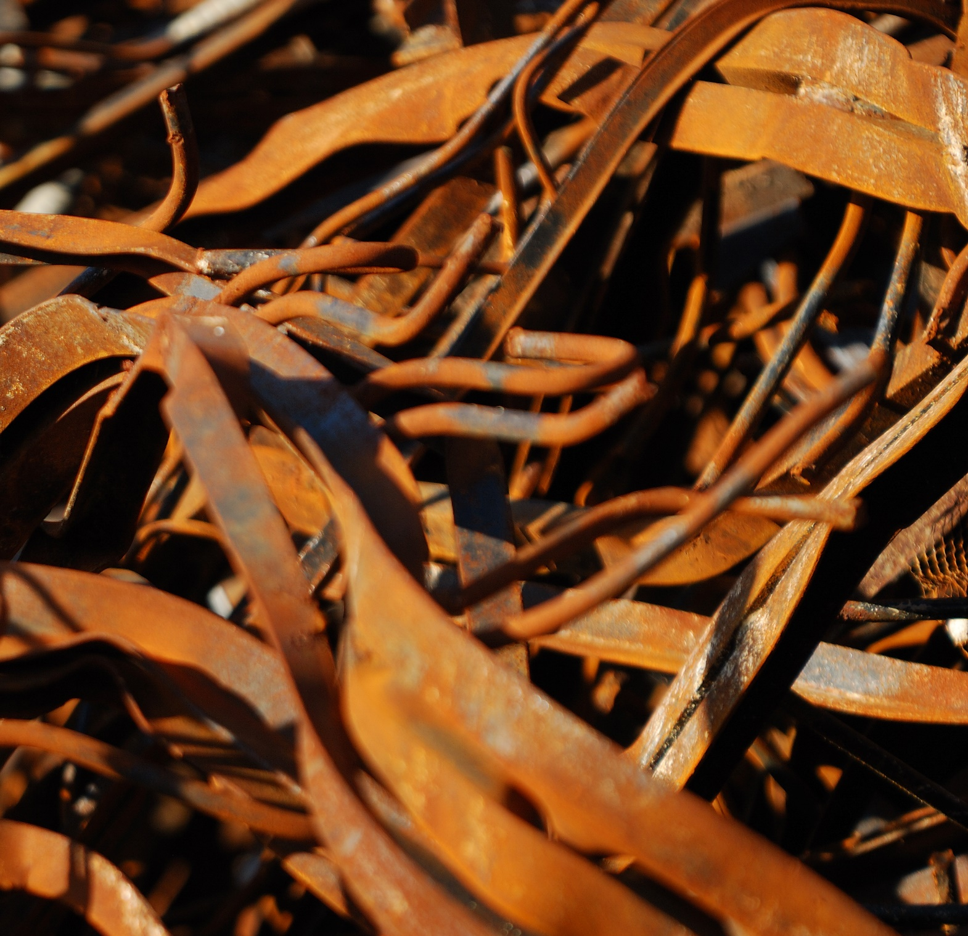
A higher recycling rate
Higher recycling rates support a less negative climate impact.
Working extensively with material recycling can lower the energy consumption in production of virgin resources.
Lower energy consumption means reduced carbon dioxide emissions. This is beneficial for your company, working with sustainability as a core part of the business

Slide 9
A higher recycling rate
Are you in control
of your recycling rates?
By making sure your business is benefiting from a higher recycling rate you also contribute to a more sustainable society.
Notes:
There are several gains and benefits coming from recycling to a higher degree. These benefits include:
saving material, time, energy
having a less negative climate impact.

