Slide 1
From Waste to product
Innovative, efficient and complex processes allow for more than 90 % recycling of the electronic waste.

Slide 2
From Waste to product
There is a lot of valuable material in our electronics. And when we globally produce some 50 million tonnes of electronic waste each year, we must learn how to recycle a lot more. To build a circular future.
Proper recycling of the electronics waste can make sure that these resources already in the loop, stays in the loop. As we want to make sure that the materials can be used in new products. This infographic shows what we do with the materials, making sure they come to good use again.

Slide 3
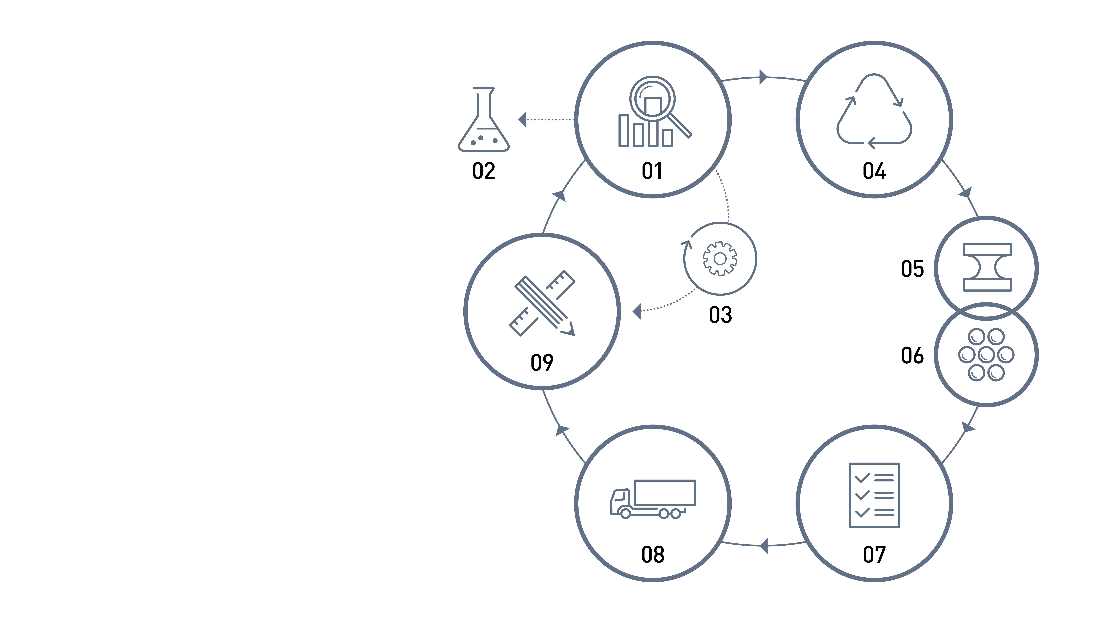
From Waste to product
Overview of the steps to close the circle
01. First treatment
02. Hazardous waste
03. Reuse
04. Recycling
05. Metals
06. Plastic
07. Tests
08. Allocation
09. New products

Slide 4
From Waste to product
01
FIRST TREATMENT
Manual sorting of all electronics.

Slide 5
From Waste to product
02
HAZARDOUS WASTE
We take care of the hazardous materials, for example, batteries, mercury and toxic plastic. It’s all recycled separately.

Slide 6
From Waste to product
03
REUSE
Some products or parts can be reused helping to prolong the product life. It is an important step up in the waste hierarchy.

Slide 7
From Waste to product
04
RECYCLING
There are some 25 different processes for recycling the materials in electronic waste. For example:
- Mechanical treatment downsizing the waste
- Fans, magnets and liquid baths separating material types
- Sieves sorting materials in different sizes

Slide 8
From Waste to product
05
METALS
Metals are separated and upgraded, sorted into different grades and alloys of metals.
We also extract precious metals, apart from the other metals.

Slide 9
From Waste to product
06
PLASTIC
Refining and sorting, either to PP/PE flakes or to PS or ABS granules.

Slide 10
From Waste to product
07
TESTS
The quality of the recycled material is continuously tested to be used in premium products.

Slide 11
From Waste to product
08
ALLOCATION
Among buyers of the refined materials you find steel mills, smelters, foundries, plastics producers and more. Here are some of the specified materials and their uses.

Slide 12
From Waste to product
09
NEW PRODUCTS
Anything made from metal and plastic.

