Slide 1
setting business goals to Manage your recycling

Slide 2
Better economy, more sustainability
Business goals supporting waste management
Creating goals for your business provides clarity, for employees as well as for customers and consumers.
The goals shown here are relatively simple to create, as they allow you to see the development of waste management over time.

Slide 3
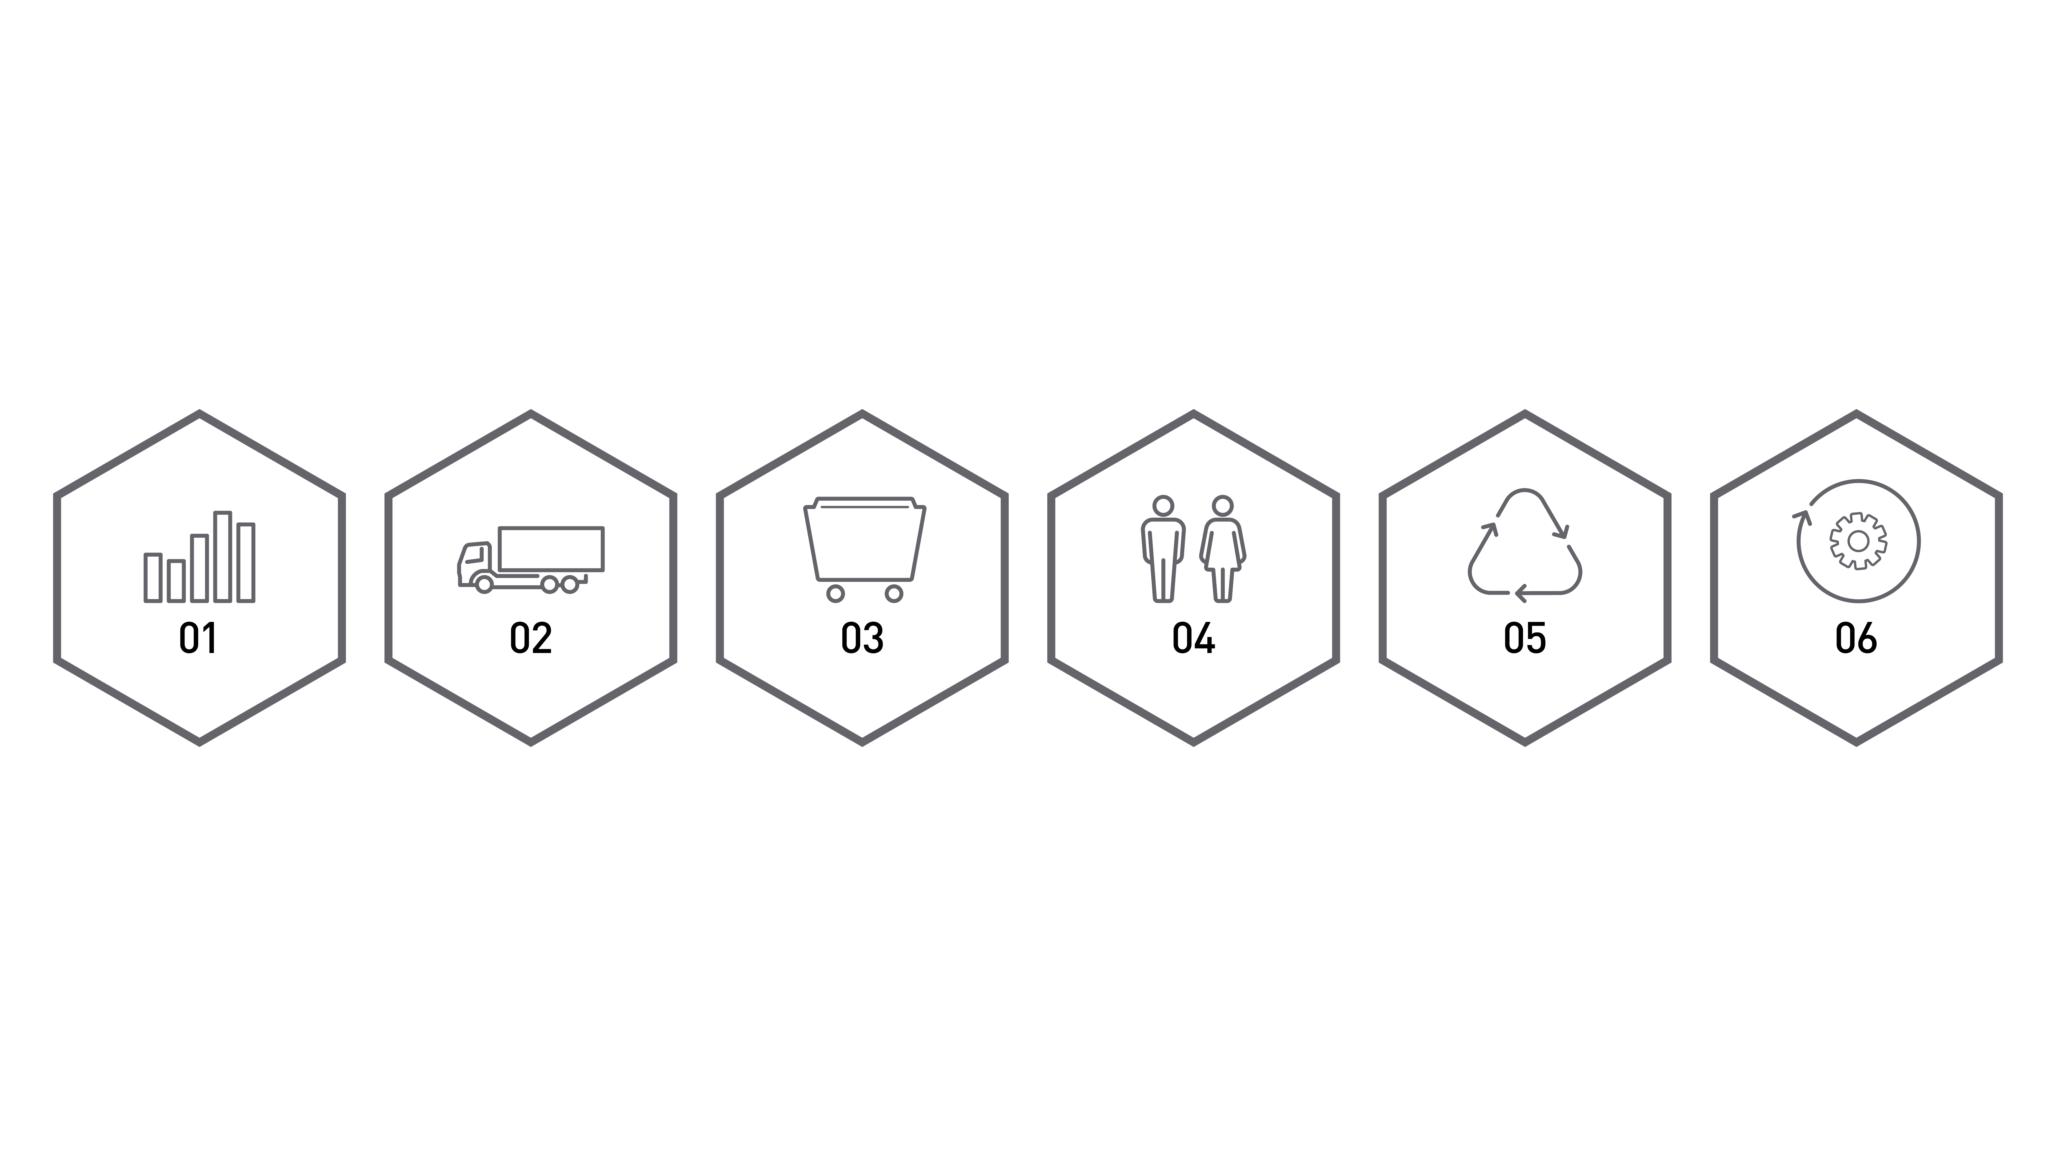
Business goals supporting waste management
Overview of the goals
Degree of recycling
Transports
Waste numbers
Staff
Recyclability
Materials recycled

Slide 4
Business goals supporting waste management
01
DEGREE OF RECYCLING
A goal directly linked to waste management is how much of the wastes that can be lifted in the waste hierarchy. These movements (including quantities of wastes lifted) can be measured and compared. This can also be easily used in your sustainability communication.
Degree of recycling of wastes.

Slide 5
Business goals supporting waste management
02
TRANSPORTS
The amount of transport and logistics required for waste management. How it is handled and packed will affect, for example, the number of waste transports.
Logistics for waste management, number of transports.
Transports, optimization of payloads.

Slide 6
Business goals supporting waste management
03
WASTE NUMBERS
Goals how to reduce the total amount of waste produced. Some materials have a waste value, while other waste must be treated as a cost. Both can be important when setting goals.
Amount of waste/product.
Costs for and revenue from waste.
The total amount of waste produced.

Slide 7
Business goals supporting waste management
04
STAFF
Important for correct sorting at the source and for managing the risks that may occur. There is also an opportunity to set clear goals regarding the degree and transfer of skills.
Number of trained employees.
Number of completed courses/employees.

Slide 8
Business goals supporting waste management
05
RECYCLABILITY
Describes the percentage of the product that can be recycled. This is a goal where good results can be used in a rewarding way in your external communication.
Recyclability of product, by percentage.

Slide 9
Business goals supporting waste management
06
RECYCLED MATERIALS
These goals describe the proportion of recycled materials used.
Percentage of recycled material used, for packaging and product respectively.
Percentage of recycled material used in production.

Slide 10
Business goals supporting waste management
Overview of the goals
Degree of recycling
Transports
Waste numbers
Staff
Recyclability
Materials recycled

