Slide 1
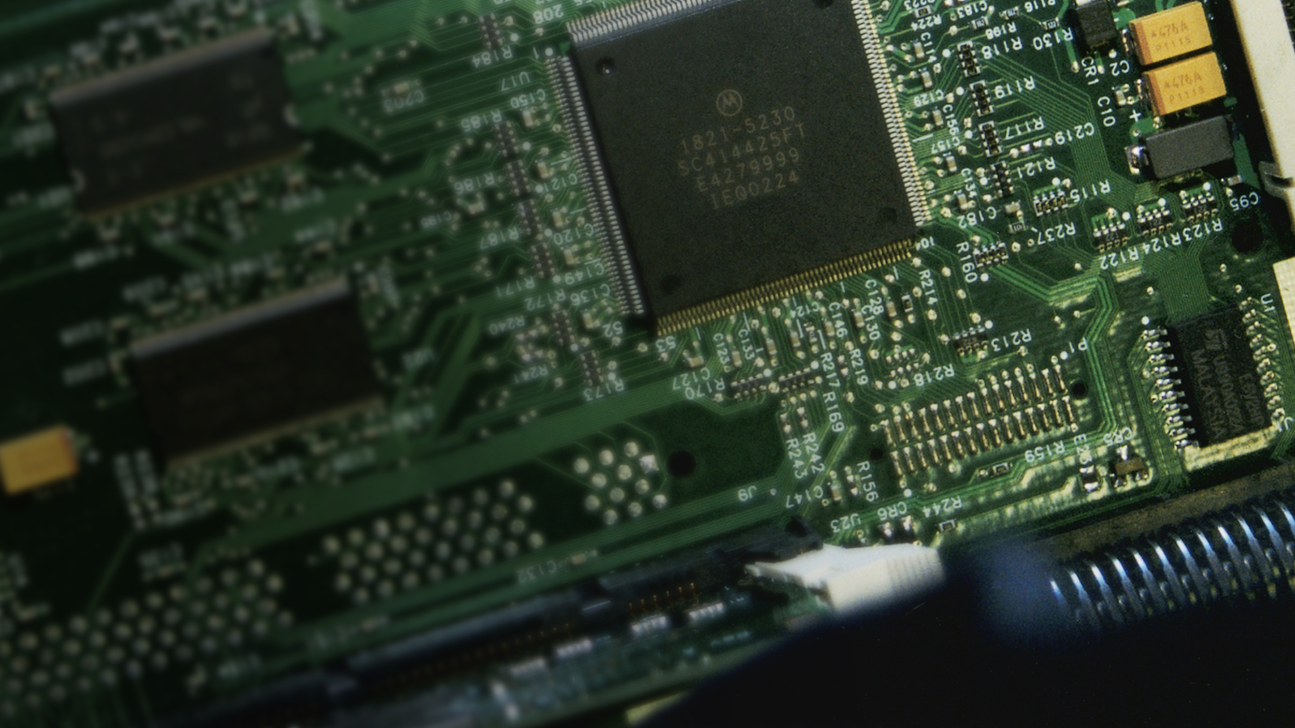
WEEE*
management
setup
Five tips for your electronic waste management.
*WEEE = Waste from Electrical and Electronic Equipment

Slide 2
A guide for those responsible
of your company’s electronic waste
WEEE management setup
Some simple tips on what to think about, when setting up a well-functioning
electronics waste management solution.

Slide 3
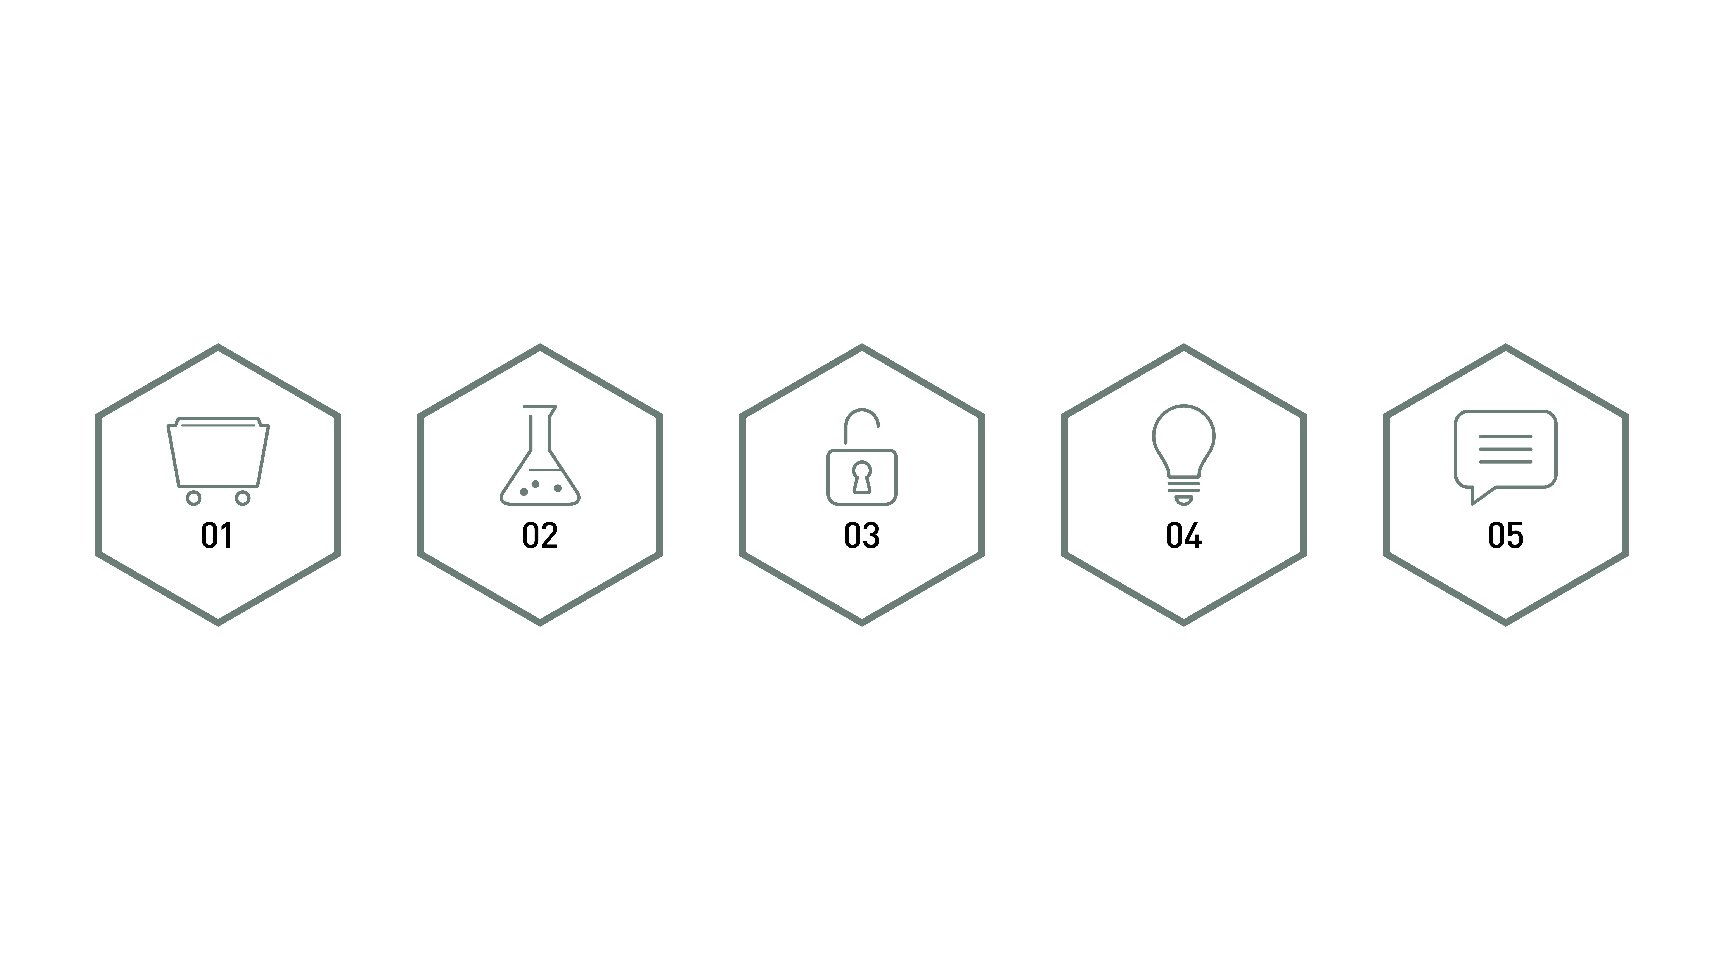
WEEE management setup
The five basic tips
Sorting
Hazardous
waste
Security
Knowledge
sharing
Communications

Slide 4

WEEE management setup
01
SORTING
Keep track of everything that leaves your business.
Know how to sort the production spill and waste.
Have the right containers and know which waste goes where.
Have proper transports routines.
Log all the waste that leaves your business.
Keep track of your waste quantities and qualities,
as it prevents unnecessary costs.

Slide 5

WEEE management setup
02
HAZARDOUS WASTE
Electronics may contain hazardous substances and are classified as
hazardous waste. These three routines should be part of your management.
Battery handling.
Hazardous waste management.
Tracking hazardous waste transport.

Slide 6

WEEE management setup
03
SECURITY
With both hazardous waste and sensitive information in electronics,
it’s important with working routines for computers and other advanced
electronic devices.
Safe hazardous waste management.
Secured information management.
Use competent professionals in waste management transports
and collection.

Slide 7

WEEE management setup
04
KNOWLEDGE SHARING
It is important that your employees really know how to handle electronic waste.
Staff training routines.
Skill transfer routines.
Accessible information on regulation and routines.

Slide 8

WEEE management setup
05
COMMUNICATIONS
The information efforts for electronic waste concerns both internal
and external communications.
Accessible waste management routines, in a suitable place.
The binder/digital solution should be easy to find.
Measure your waste goals and communicate them.
Use sustainability communication, for both brand-building
marketing and viable customer information.

Slide 9
Conclusion
WEEE management setup
Maintaining control over sorting, hazardous waste, security, knowledge sharing
and communications provides you with a sound basis for waste management.
Also, remember to consider how they all should connect to become a part of the daily
work routines at your workplace.

Slide 10



